Slide 1
MINESWEEPER
SOLVER
TERM PROJECT : ALGORITHMS -1

Slide 2
Jyotiraditya
19CH10017
OUR TEAM
S.S.S.Vardhan
19CH30018
Rishi Suvvada
19CH10058
We are a group of chemical engineers finding our way to integrate the concepts of chemical engineering and computer science

Slide 3
TABLE OF CONTENTS
01
02
03
04
MOTIVATION
INTRODUCTION AND IDEA
Describing what motivated us to choose this problem statement
Describing the problem statement, strategy used, pseudo code
C++ CODE
ANALYSIS
Describing the implementation of the algorithm
Checking how efficient our algorithm works
Notes:
We start with the motivation behind choosing the topic followed by introduction and our idea to solve the problem statement, then we describe the implementation of the idea and finally check the time and space complexity of our code

Slide 4
—THE WORD ARCHITECT
“The only game i played without understanding the logic is "Minesweeper" Clicking random tiles but still losing.”
Notes:
Let’s start with a famous quote ..” The only game I played without understanding the logic “Minesweeper” clicking random tiles but still loosing by word architect

Slide 5
01
MOTIVATION
Describing what motivated us to choose this problem statement
Notes:
The MOTIVATION behind our idea

Slide 6
MOTIVATION
From soccer to Sudoku, Go to Connect Four, games have fascinated and challenged mathematicians and computer scientists for centuries. Oftentimes, a game may have a straightforward premise or a simple set of rules yet when scholars analyze it closer, a plethora of complex and intriguing problems emerge. It is this deceptive and sometimes unexpected depth that draws scholars to rigorously study games.Chess, on the other hand, has had a long legacy in computer science. For decades, programming a computer to successfully beat humans at chess was seen as the pinnacle of artificial intelligence. Now, there exist supercomputers which manage to beat the world champions of chess. Minesweeper is another example of a game with a simple set of rules yet challenging implications. In fact, Minesweeper is in a class of mathematically difficult problems known as co-NP-complete. Therefore, understanding the complexity of Minesweeper and designing algorithms to solve it may prove useful to other related problems.
Notes:
From soccer to Sudoku, Go to Connect Four, games have fascinated and challenged mathematicians and computer scientists for centuries. Oftentimes, a game may have a straightforward premise or a simple set of rules yet when scholars analyze it closer, a plethora of complex and intriguing problems emerge. It is this deceptive and sometimes unexpected depth that draws scholars to rigorously study games.Chess, on the other hand, has had a long legacy in computer science. For decades, programming a computer to successfully beat humans at chess was seen as the pinnacle of artificial intelligence. Now, there exist supercomputers which manage to beat the world champions of chess. Minesweeper is another example of a game with a simple set of rules yet challenging implications. In fact, Minesweeper is in a class of mathematically difficult problems known as co-NP-complete. Therefore, understanding the complexity of Minesweeper and designing algorithms to solve it may prove useful to other related problems.

Slide 7
02
INTRODUCTION
AND IDEA
Describing the problem statement, strategy used, pseudo code
Notes:
Introduction and Our Idea

Slide 8
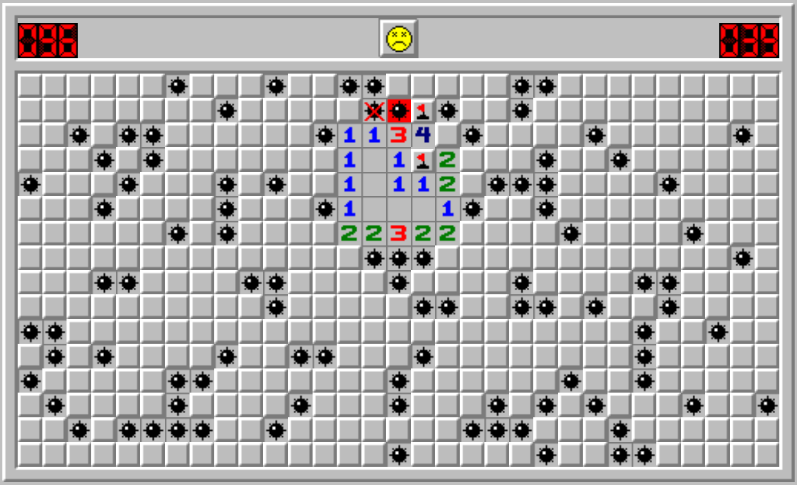

WHAT IS MINESWEEPER?
Minesweeper is a single-player puzzle video game. The objective of the game is to clear a rectangular board containing hidden "mines" or bombs without detonating any of them, with help from clues about the number of neighboring mines in each field. If a cell where a mine is present is clicked then we lose, else we are still in the game. Each turn, the player may probe or uncover a square revealing either a mine or an integer. This integer represents the number of mines adjacent to that particular square. As such, the number on a cell ranges from 0 to 8 since a cell cannot have more than eight neighbors.neighbors. The game ends when the player probes a cell containing
a mine. The goal of the game is to uncover every square that does not contain a
mine.
Notes:
Minesweeper is a single-player puzzle video game. The objective of the game is to clear a rectangular board containing hidden "mines" or bombs without detonating any of them, with help from clues about the number of neighboring mines in each field. If a cell where a mine is present is clicked then we lose, else we are still in the game. Each turn, the player may probe or uncover a square revealing either a mine or an integer. This integer represents the number of mines adjacent to that particular square. As such, the number on a cell ranges from 0 to 8 since a cell cannot have more than eight neighbors.neighbors. The game ends when the player probes a cell containing
a mine. The goal of the game is to uncover every square that does not contain a
mine.

Slide 9
THE PROBLEM
Given a 2D array arr[][] of dimensions N*M, representing a minesweeper matrix, where each cell contains an integer from the range [0, 9], representing the number of mines in itself and all the eight cells adjacent to it, the task is to solve the minesweeper and uncover all the mines in the matrix. Print ‘X’ for the cell containing a mine and ‘_’ for all the other empty cells. If it is not possible to solve the minesweeper, then print “-1”.
Notes:
The Problem - Given a 2D array arr[][] of dimensions N*M, representing a minesweeper matrix, where each cell contains an integer from the range [0, 9], representing the number of mines in itself and all the eight cells adjacent to it, the task is to solve the minesweeper and uncover all the mines in the matrix. Print ‘X’ for the cell containing a mine and ‘_’ for all the other empty cells. If it is not possible to solve the minesweeper, then print “-1”.

Slide 10
THE SOLUTION
The given problem can be solved using Backtracking. The idea is to iterate over each cell of a matrix, based on the information available from the neighboring cells, assign a mine to that cell or not.
Notes:
The Solution - The given problem can be solved using Backtracking. The idea is to iterate over each cell of a matrix, based on the information available from the neighboring cells, assign a mine to that cell or not.

Slide 11

STRATEGY
Check if all the nodes visited and the array is zero_matrix, if yes then return the answer and terminate.
If all the nodes visited but array!= zero matrix then no answer
Mark the current node as mine and decrease surrounding node values in array by 1
Recursively call solver function for the new array state
Backtrack by retrieving the changes done in array by adding 1 to all the nodes changed
Recursively call the solver function
Notes:
Strategy used - Check if all the nodes visited and the array is zero_matrix, if yes then return the answer and terminate.
If all the nodes visited but array!= zero matrix then no answer
Mark the current node as mine and decrease surrounding node values in array by 1
Recursively call solver function for the new array state
Backtrack by retrieving the changes done in array by adding 1 to all the nodes changed
Recursively call the solver function

Slide 12
INPUT
OUTPUT
The user has to provide an automated input : The code will randomly generate a valid grid based on time seed, no. of rows, columns and mine probability.
A grid containing the positions of the mines placed if the grid is a valid grid else displays a error message

Slide 13
PSEUDOCODE
solve_minesweeper(array,mine){
if(all_nodes_visited and array_is_zero_matrix){
return mine_position;
}
else if(all_nodes_visited){
return no_answer;
}
mine[current_node] = 1;
array[neighbouring_nodes]--;
solve_minesweeper(array,mine);
mine[current_node] = 0;
array[neighbouring_nodes]++;
solve_minesweeper(array,mine);
return;
}
MINESWEEPER SOLVER

Slide 14
03
C++ Code
Describing the implementation of the algorithm

Slide 15
INPUT GENERATING FUNCTIONS
User has to input the rows, cols and probability of finding the mine in the grid
void mineGenerator(int mineGrid[CMAX][CMAX], int row, int col, int mine) { srand(time(NULL)); int seed; int mines[row][col]; for (int i = 0; i < row; i++) { for (int j = 0; j < col; j++) { seed = rand() % 100; if (seed < mine) mines[i][j] = true; else mines[i][j] = false; } }

Slide 16
INPUT GENERATING FUNCTIONS
CONTD…
cout << "User Input:\n"; for (int i = 0; i < row; i++) { for (int j = 0; j < col; j++) { mineGrid[i][j] = 0; for (int k = 0; k < 9; k++) { if (isValid(i + dirx[k], j + diry[k]) && (mines[i + dirx[k]][j + diry[k]])) mineGrid[i][j]++; } cout << mineGrid[i][j] << " "; } cout << endl; } }

Slide 17
HELPER FUNCTIONS
Find unvisited nodes
Are all mines found
bool findUnvisited(bool visited[CMAX][RMAX], int& x, int& y) { for (x = 0; x < row; x++) { for (y = 0; y < col; y++) { if (!visited[x][y]) return true; } } return false; }
bool isDone(int mineGrid[CMAX][RMAX], bool visited[CMAX][RMAX]) { bool done = true; for (int i = 0; i < row; i++) { for (int j = 0; j < col; j++) { done = done && (mineGrid[i][j] == 0) && visited[i][j]; } } return done; }

Slide 18
HELPER FUNCTIONS
Find if Node is Valid
Is it safe to place a mine
bool isValid(int x, int y) { return (x >= 0 && y >= 0 && x < row && y < col); } void printGrid(bool grid[CMAX][RMAX]) {
for (int i = 0; i < row; i++) { for (int j = 0; j < col; j++) { if (grid[i][j]) cout << " *"; else cout << " _"; } cout << "\n"; } }
bool isSafe(int mineGrid[CMAX][RMAX], int x, int y) { if (!isValid(x, y)) return false; for (int i = 0; i < 9; i++) { if (isValid(x + dirx[i], y + diry[i]) && (mineGrid[x + dirx[i]][y + diry[i]] - 1 < 0)) return false; } for (int i = 0; i < 9; i++) { if (isValid(x + dirx[i], y + diry[i])) mineGrid[x + dirx[i]][y + diry[i]]--; } return true; }

Slide 19
BACKTRACKING FUNCTION (RECURSION)
bool mineSolverUtil(bool grid[CMAX][RMAX], int mineGrid[CMAX][RMAX], bool visited[CMAX][RMAX]) { if (isDone(mineGrid, visited)) return true; int x, y; if (!findUnvisited(visited, x, y)) return false; visited[x][y] = true; if (isSafe(mineGrid, x, y)) { grid[x][y] = true; if (mineSolverUtil(grid, mineGrid, visited))
return true; grid[x][y] = false; for (int i = 0; i < 9; i++) { if (isValid(x + dirx[i], y + diry[i])) mineGrid[x + dirx[i]][y + diry[i]]++; } } if (mineSolverUtil(grid, mineGrid, visited)) return true; visited[x][y] = false; return false; }

Slide 20
BACKTRACKING FUNCTION (RECURSION)
void mineSolver(int mineGrid[CMAX][CMAX], int row, int col) { bool grid[CMAX][RMAX]; bool visited[CMAX][RMAX]; memset(grid, false, sizeof(grid)); memset(visited, false, sizeof(visited)); if (mineSolverUtil(grid, mineGrid, visited)) printGrid(grid); else printf("No solution exists\n"); } };

Slide 21
MAIN FUNCTION
int main() { MineSweeper m; // User input cout << "Enter rows (max. 100): "; cin >> m.row; cout << "Enter columns (max. 100): "; cin >> m.col; cout << "Enter mines probability (max. 100): "; cin >> m.mine; m.mineGenerator(m.mineGrid, m.row, m.col, m.mine); m.mineSolver(m.mineGrid, m.row, m.col); return 0; }

Slide 22
04
ANALYSIS
Checking how efficient our algorithm works

Slide 23
TIME AND SPACE COMPLEXITY
TIME COMPLEXITY
SPACE COMPLEXITY
When using backtracking we either consider a node as a mine or don’t , so when we consider a node as mine we recursively traverse to remaining N*M nodes to check the final satisfying condition of minesweeper , same goes when we don’t consider it as a mine there for O(2^{N * M}), As we consider the same thing for all the nodes in the array , Thus TIme complexity will be O(2^{N * M} * N * M)
We used 3 N*M arrays in the whole code. As, at every point of time we passed the arrays by reference the total space used will be 3*N*M , Therefore the Space complexity is O(N*M)

Slide 24
Jyotiraditya
Backtracking Function and PPT
S.S.S.Vardhan
Helper Functions and PPT
CONTRIBUTION
Rishi Suvvada
Generator Function and PPT

Slide 25
THANK YOU
CHALLENGE
MINESWEEPER SOLVER
CODING
C++ Code
RESULTS
Time Complexity
Space Complexity

